Slide 1



Online Payment Fraud Detection Using ML
By Swapnil P. ,Archana T. , Shreyash J. (Batch No. 7961)
Notes:
class_1_over = class_1.sample(class_count_0, replace=True)

Slide 2
Introduction
In this machine learning project, we solve the problem of online transactions fraud detecting using machine numpy, scikit learn, and few other python libraries. We overcome the problem by creating a binary classifier and experimenting with various machine learning techniques to see which fits better.

Slide 3
Project Timeline
Data Understanding
Here, we need to load the data and understand the features present in it. This would help us choose the features that we will need for your final model.
Inspecting Data
Data Visualization
Representation of information in the form of a chart, diagram, picture, etc. using matplotlib, seaborn libraries
EDA
Data Preprocessing
Algorithm
Encoding of Type column
LogisticRegression
XGBClassifier
RandomForestClassifier
KNN
Decision Tree
Treating null and duplicates values
Checking statistical aspects of the dataframe
Dropping irrelevant columns like nameOrig, nameDest
Data Splitting

Slide 4
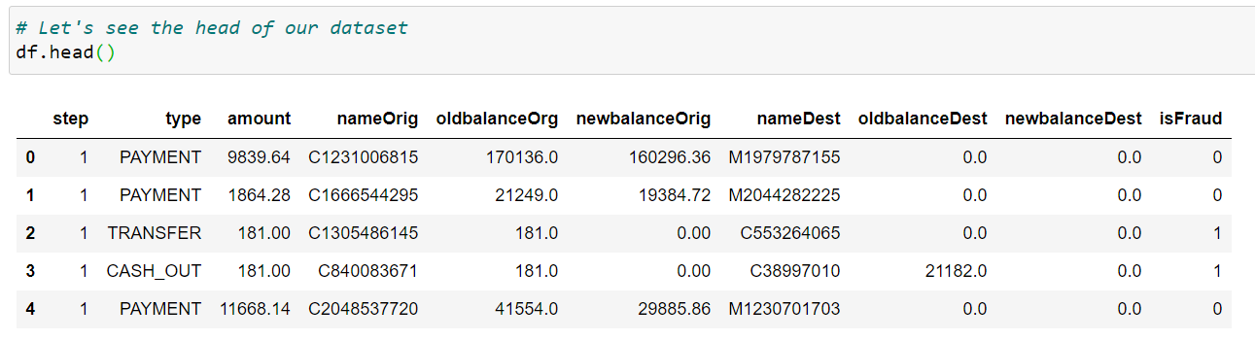
Problem Statement &Data Mining
The problem statement chosen for this project is to predict fraudulent credit card transactions with the help of machine learning models.
In this project, we will analyse customer-level data which has been collected and analysed during a research collaboration of Worldline and the Machine Learning Group.
The dataset is taken from the Kaggle Website website and it has a total of 440968 transactions, out of which 535 are fraudulent. Since the dataset is highly imbalanced, so it needs to be handled before model building.

Slide 5
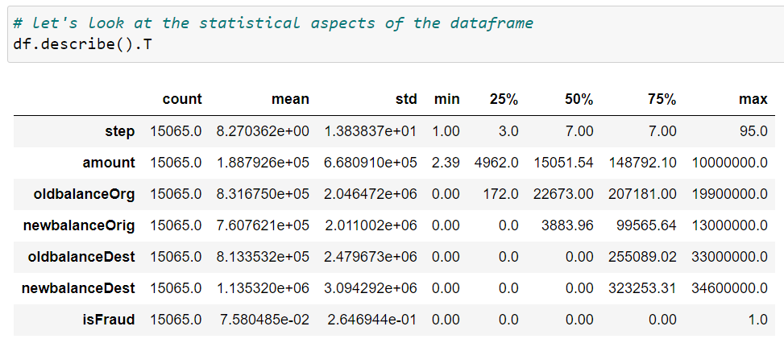
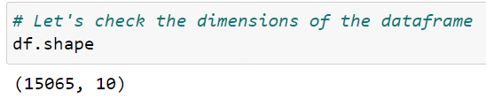
EDA
Categorical Data - type, nameOrig, nameDest, isFraud
Continuous Data - Amount,oldbalanceOrg, newbalanceOrig etc.

Slide 6
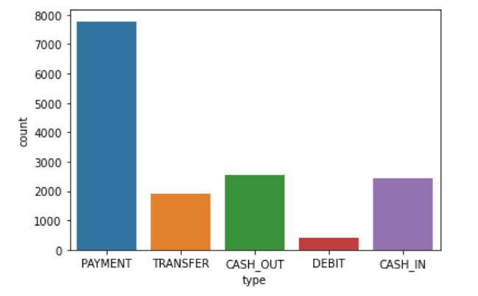
Data Visualization
Libraries used for data visualization
matplotlib.pyplot
Seaborn
Countplot
sns.countplot(x='type', data=df)

Slide 7
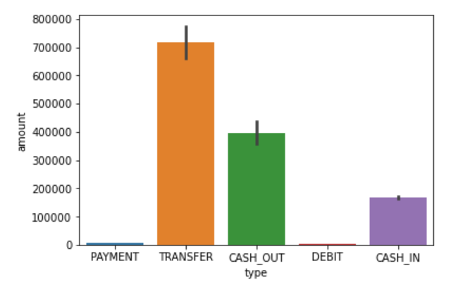
Barplot
sns.barplot(x='type', y='amount', data=df)

Slide 8
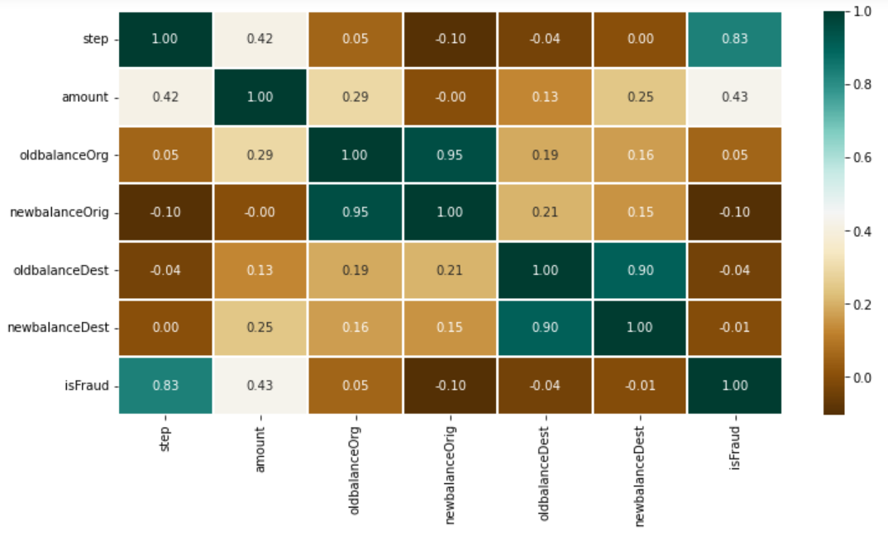
Heatmap
plt.figure(figsize=(12, 6))
sns.heatmap(df.corr(),
cmap='BrBG',
fmt='.2f',
linewidths=2,
annot=True)

Slide 9
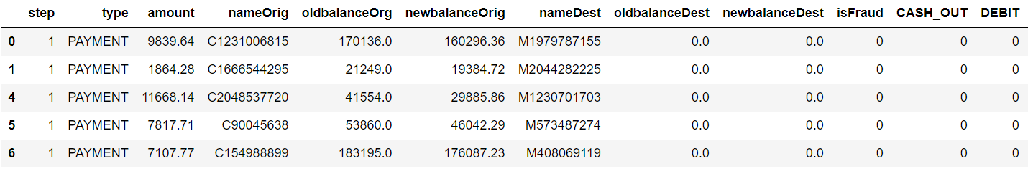
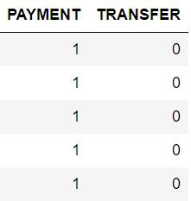
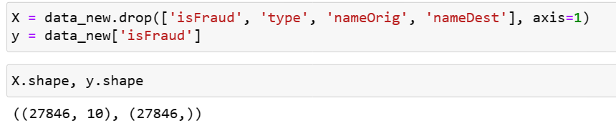
Feature Engineering
Dummy Variables
Dropping unnecessary column

Slide 10

Machine Learning Models

Slide 11
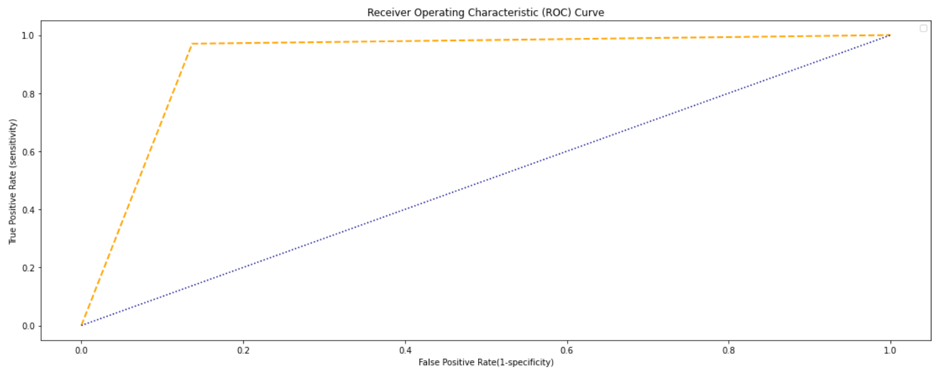
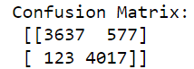
Logistic Regression
Library used : sklearn.linear_model (LogisticRegression)
Split used for training and testing the data : 70-30
Accuracy: [0.9162078]
Sensitivity : [0.96728723]
Specificity : [0.87440139]
Precision: [0.86307546]
Recall: [0.96728723]
F-score: [0.9122147]
AUC: 0.9166826589078503

Slide 12
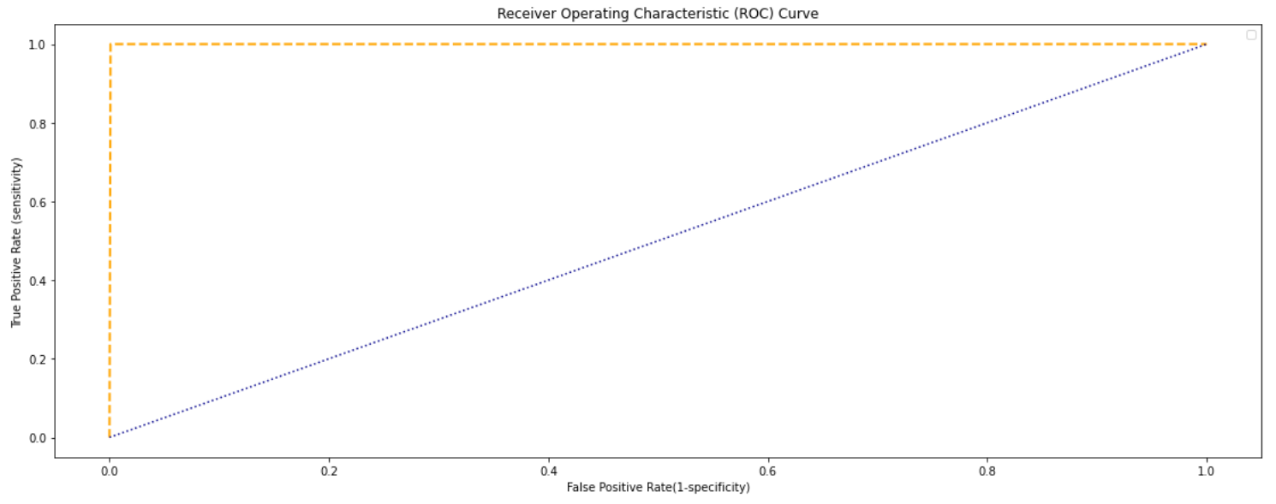
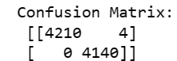
XGB
Library used : xgboost (XGBClassifier)
Split used for training and testing the data : 70-30
Accuracy: [0.99952119]
Sensitivity : [1.]
Specificity : [0.99903475]
Precision: [0.99905078]
Recall: [1.]
F-score: [0.99952517]
AUC: 0.9995253915519696

Slide 13
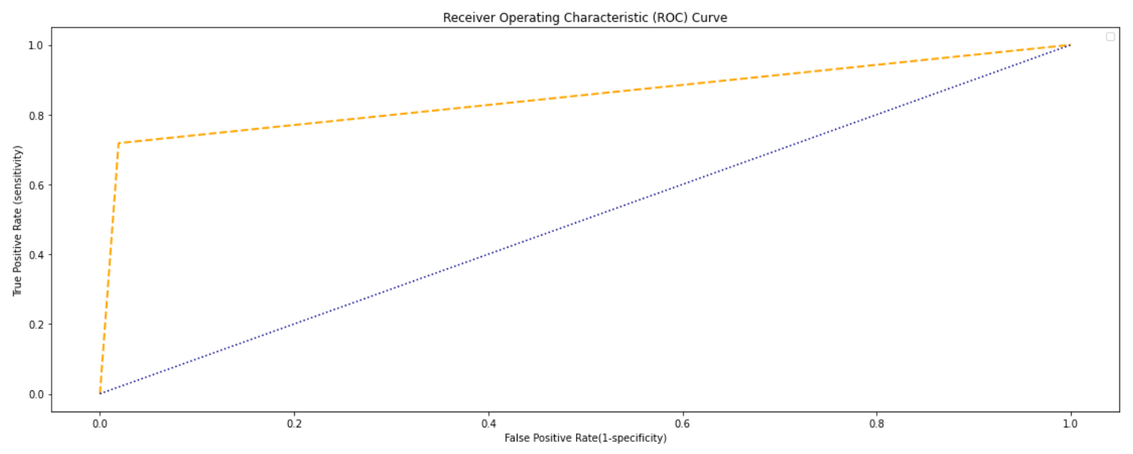
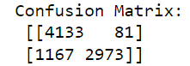
SVM
Library used : from sklearn.svm import SVC
Split used for training and testing the data : 70-30
Accuracy: [0.85061049]
Sensitivity : [0.77981132]
Specificity : [0.97347741]
Precision: [0.98077836]
Recall: [0.77981132]
F-score: [0.86882489]
AUC: 0.8494471499418776

Slide 14
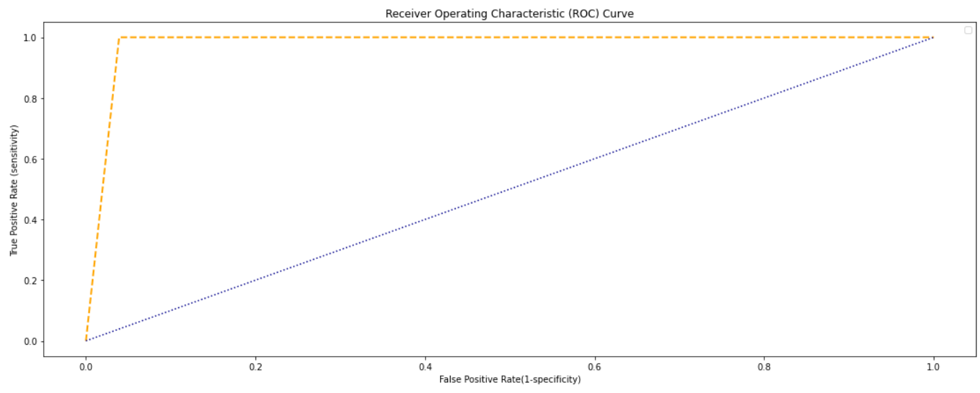
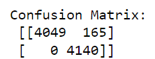
KNN
Library used : sklearn.neighbors (KNeighborsClassifier)
Split used for training and testing the data : 70-30
Accuracy: [0.98024898]
Sensitivity : [1.]
Specificity : [0.96167247]
Precision: [0.9608448]
Recall: [1.]
F-score: [0.98003147]
AUC: 0.980422401518747

Slide 15
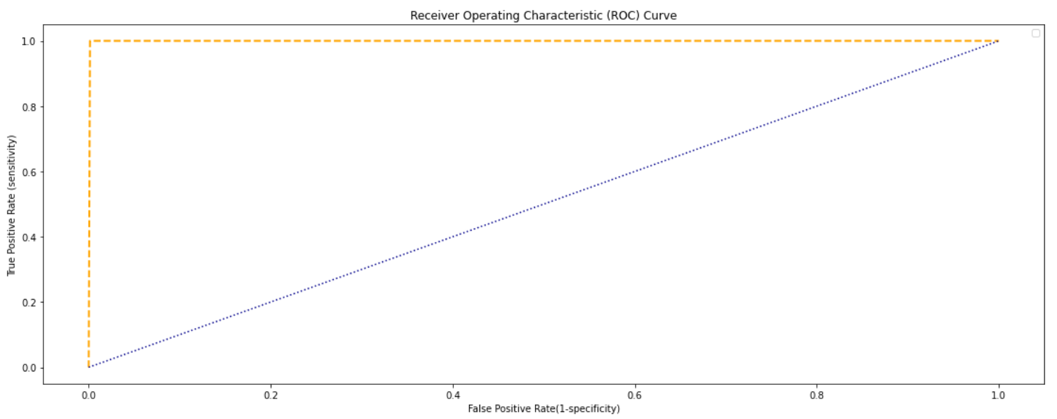
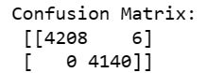
Decision Tree
Library used : sklearn.tree (DecisionTreeClassifier)
Split used for training and testing the data : 70-30
Accuracy: [0.99928178]
Sensitivity : [1.]
Specificity : [0.99855282]
Precision: [0.99857617]
Recall: [1.]
F-score: [0.99928758]
AUC: 0.9992880873279544

Slide 16
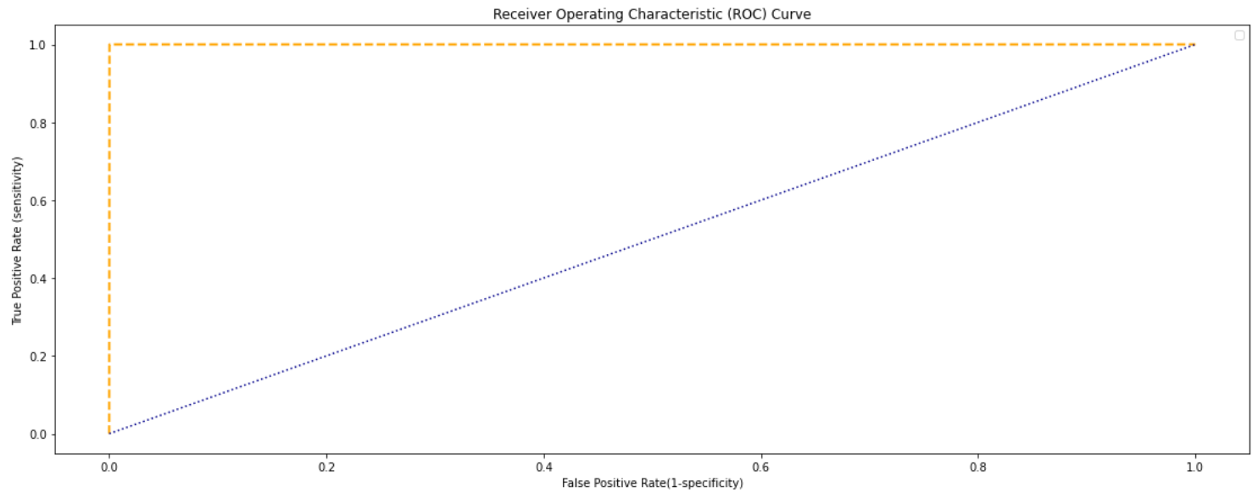
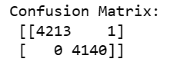
Random Forest
Library used : sklearn.ensemble (RandomForestClassifier)
Split used for training and testing the data : 70-30
Accuracy: [0.9998803]
Sensitivity : [1.]
Specificity : [0.99975851]
Precision: [0.9997627]
Recall: [1.]
F-score: [0.99988133]
AUC: 0.9998813478879924

Slide 17
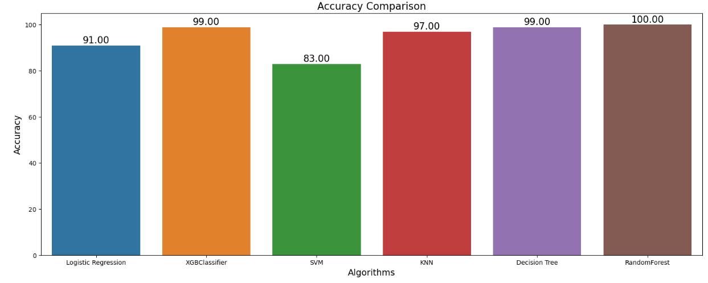
Comparing the accuracy of different model

Slide 18
So this is how we can detect online payments fraud with machine learning using Python. Detecting online payment frauds is one of the applications of data science in finance.

Slide 19


